Slide 1
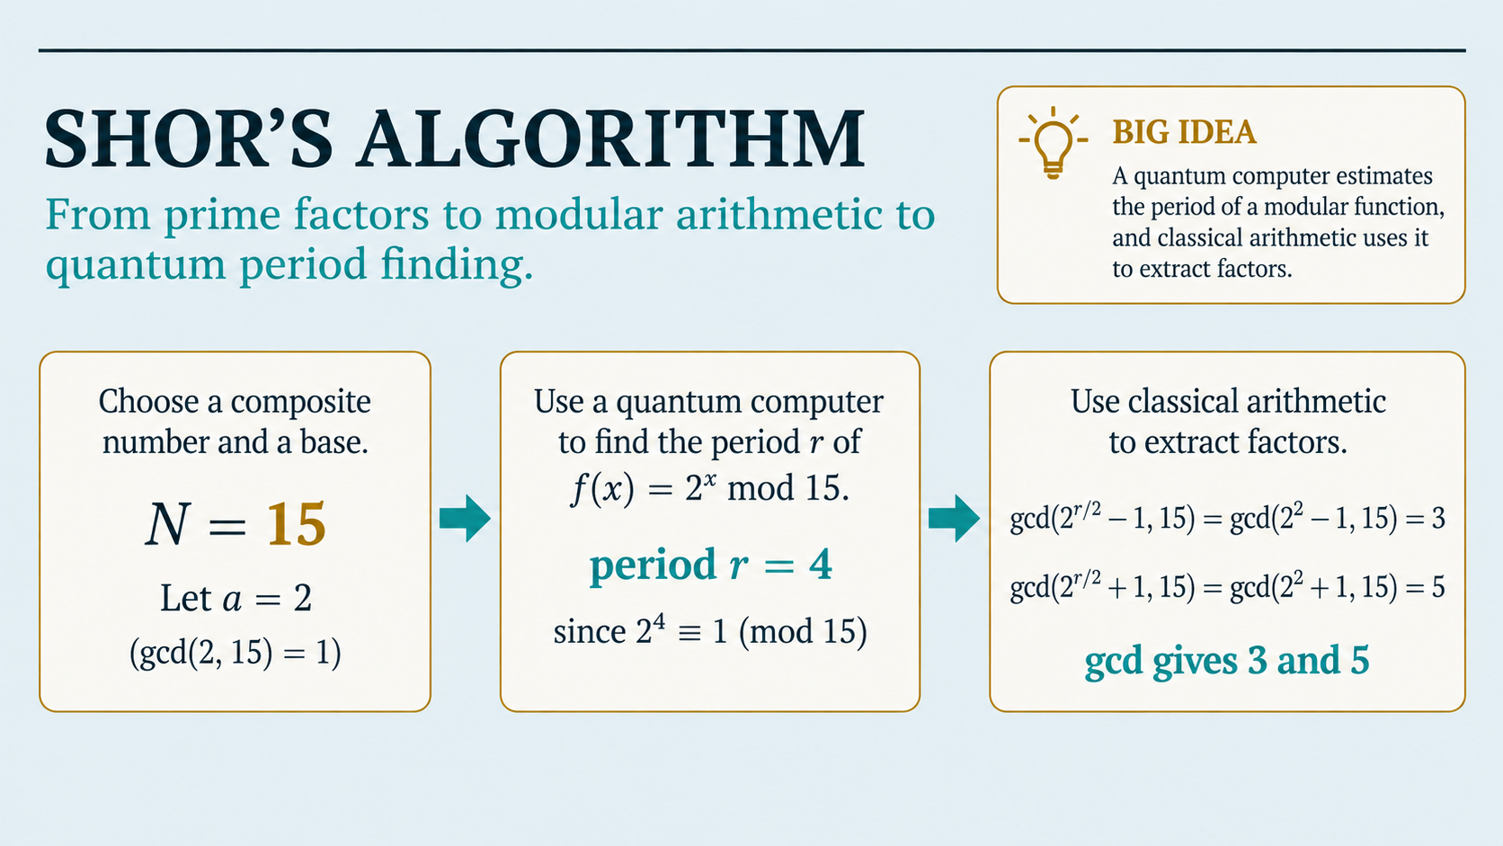

Slide 2
Week 12 Learning Objectives
Explain the factoring problem and why it matters for public-key cryptography.
Compute remainders using the modulo operator and recognize modular periodicity.
Use the Euclidean algorithm to calculate gcd(a,b).
Explain how factoring is reduced to order/period finding.
Describe the quantum order-finding circuit: superposition → modular exponentiation → inverse QFT → measurement.
Work through a complete Shor example for N = 15 and identify when the algorithm must restart.

Slide 3
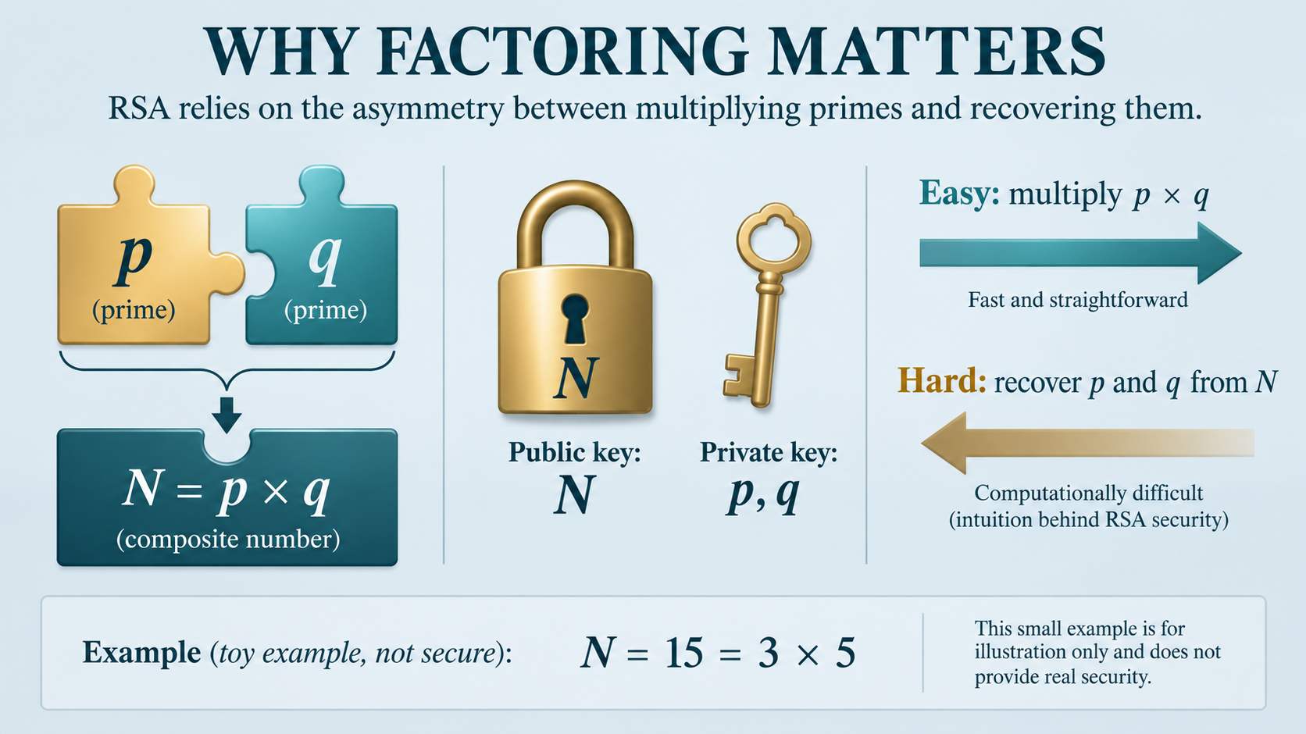

Slide 4
THE CLASSICAL Prime Factorisation PROBLEM
PRIME NUMBER
COMPOSITE NUMBER
FACTORISATION
A positive integer greater than 1 whose only positive divisors are 1 and itself.
Examples: 2, 3, 5, 7, 11.
A positive integer greater than 1 that can be written as a product of smaller positive integers.
Examples: 6, 15, 21, 35.
Find primes p₁,…,pₖ such that
N = p₁p₂…pₖ.
Example: N = 15 → 15 = 3 × 5

Slide 5
WHY LARGE FACTORING MATTERS?
Multiplication is easy; reversing it for sufficiently large N is believed hard for classical computers.
Shor showed that a fault-tolerant quantum computer can factor integers in polynomial time in the input length.
CHOOSE PRIMES
MULTIPLY
PUBLISH
ATTACKER
p and q
N = pq
N can be public
Must recover p and q

Slide 6
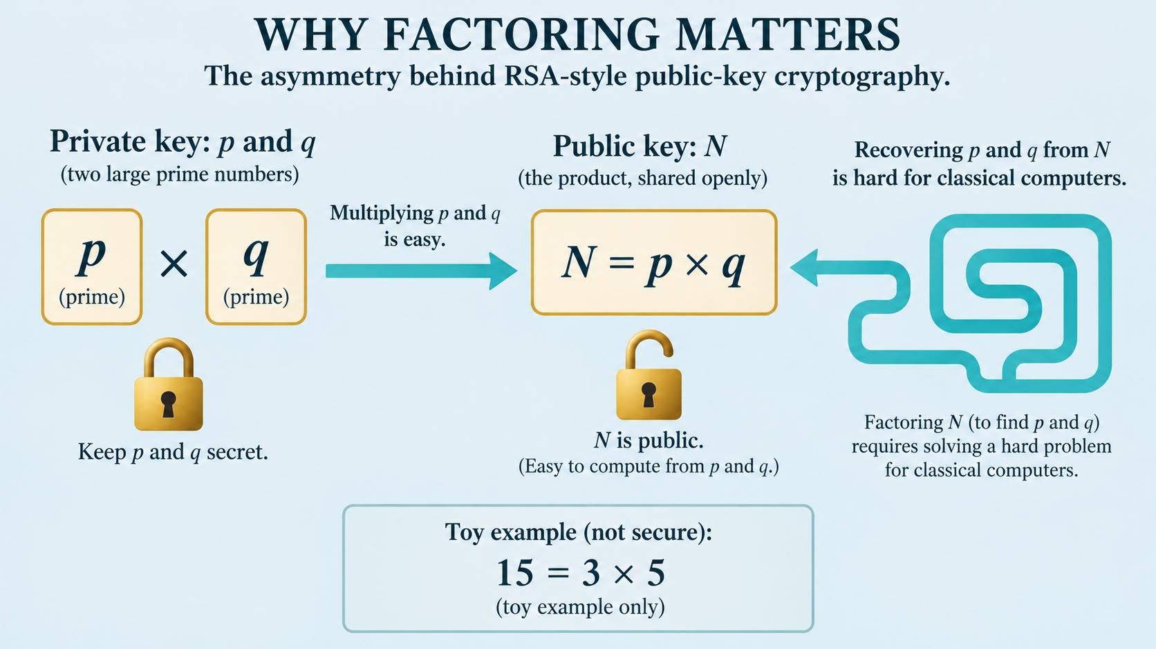

Slide 7
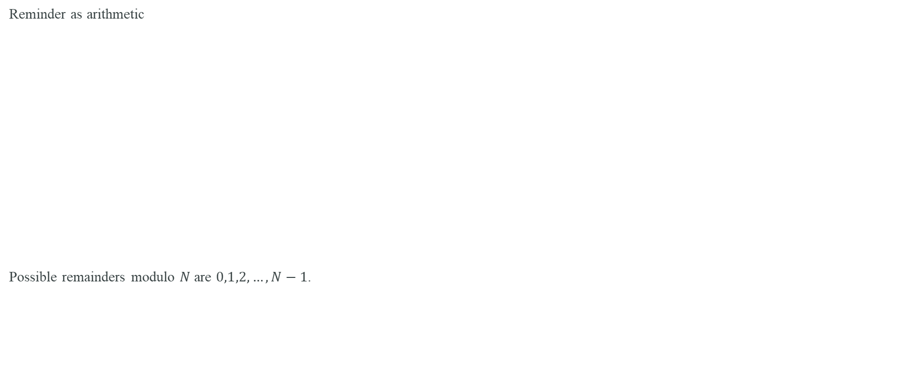
THE MODULO OPERATOR
Reminder as arithmetic
Possible remainders modulo $N$ are $0,1,2,…,N−1$.
a mod N = remainder after dividing a by N
EXAMPLE 1
EXAMPLE 2
EXAMPLE 3
17 mod 5 = 2
because 17 = 3×5 + 2
20 mod 5 = 0
so 5 divides 20
29 mod 6 = 5
because 29 = 4×6 + 5

Slide 8
MODULAR CONGRUENCE
a ≡ b (mod N) ⇔ N divides (a − b)
EXAMPLE
ANOTHER VIEW
17 ≡ 2 (mod 5)
Because 17 and 2 both leave remainder 2.
17 − 2 = 15
and 5 divides 15 exactly.
… −3, 2, 7, 12, 17, 22, … are all congruent modulo 5

Slide 9
GREATEST COMMON DIVISOR (GCD)
gcd(a,b) = largest positive integer dividing both a and b
gcd(18,12)
gcd(15,7)
COPRIME
Divisors in common: 1,2,3,6
Therefore gcd = 6
Only common divisor is 1
Therefore gcd = 1
a and N are coprime when
gcd(a,N)=1

Slide 10
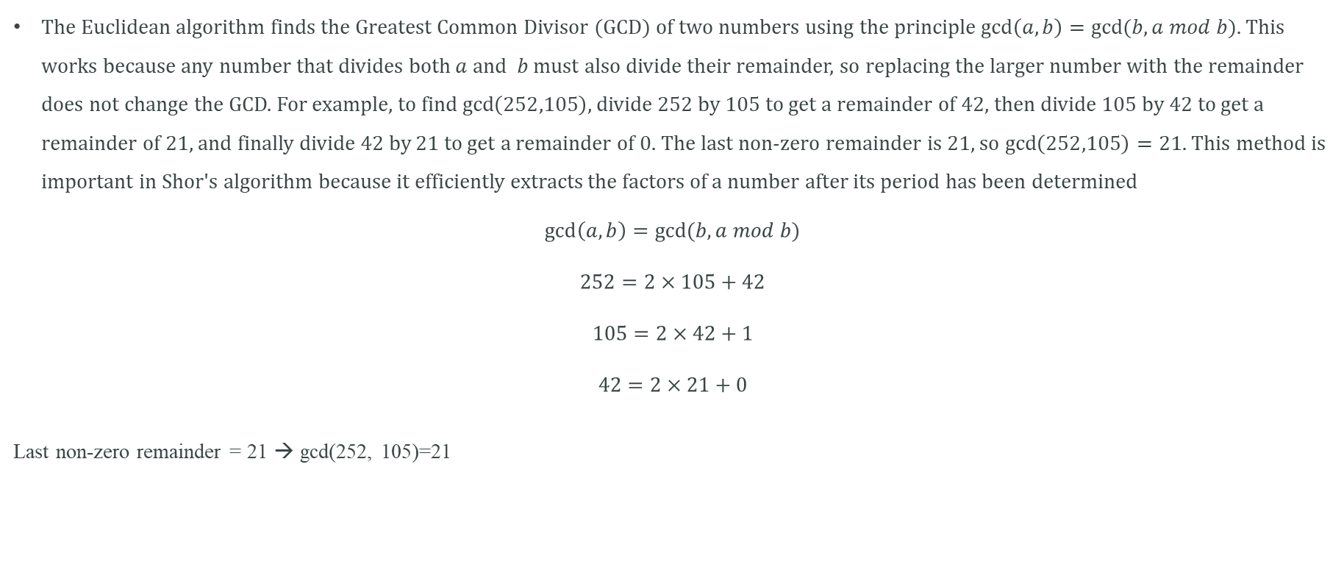
EUCLIDEAN ALGORITHM
The Euclidean algorithm finds the Greatest Common Divisor (GCD) of two numbers using the principle $\gcd\left(a,b\right)=gcd⁡(b,a mod b)$. This works because any number that divides both $a$ and $b$ must also divide their remainder, so replacing the larger number with the remainder does not change the GCD. For example, to find $\gcd\left(252,105\right)$, divide 252 by 105 to get a remainder of 42, then divide 105 by 42 to get a remainder of 21, and finally divide 42 by 21 to get a remainder of 0. The last non-zero remainder is 21, so $\gcd\left(252,105\right)=21$. This method is important in Shor's algorithm because it efficiently extracts the factors of a number after its period has been determined
$$\gcd\left(a,b\right)=gcd⁡(b, a mod b)$$
$$252=2×105+42$$
$$105=2×42+1$$
$$42=2×21+0$$
Last non-zero remainder = 21 → gcd(252, 105)=21

Slide 11
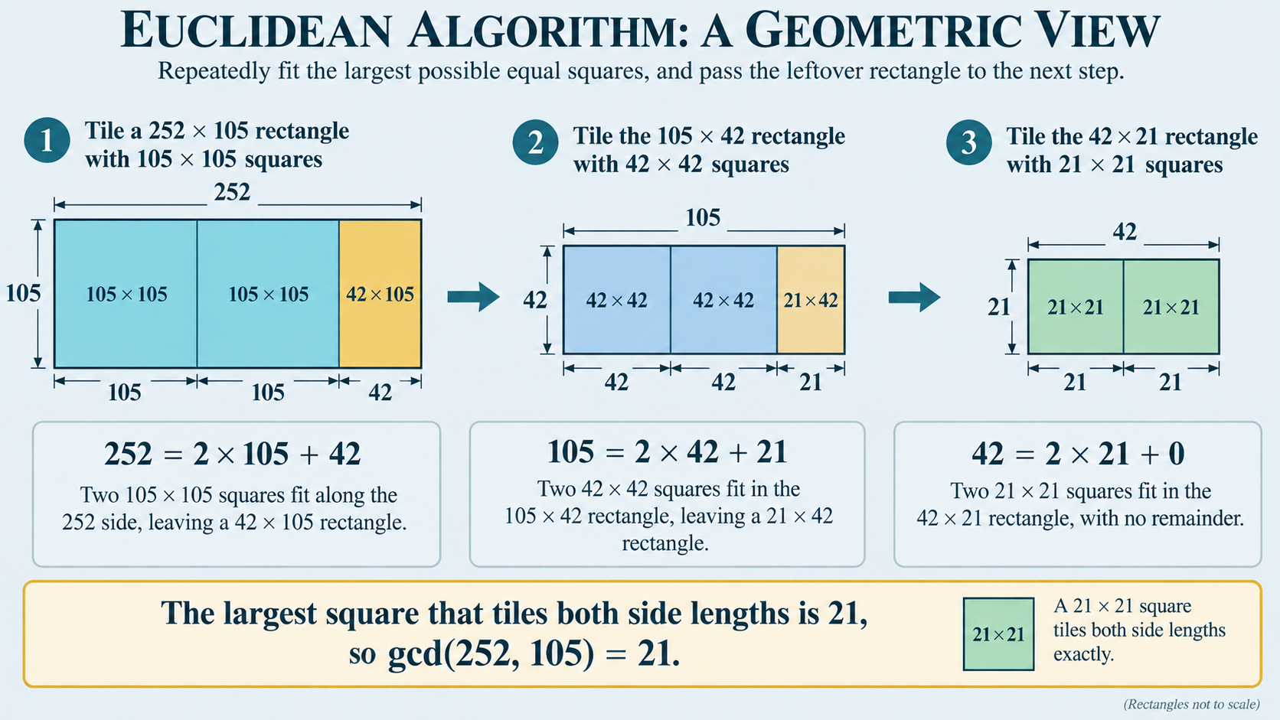

Slide 12
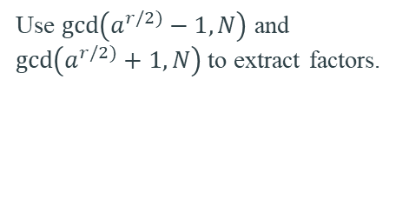
WHY GCD APPEARS IN SHOR
BEFORE QUANTUM
QUANTUM CORE
AFTER QUANTUM
Pick 1 < a < N.
Compute gcd(a,N).
If gcd > 1, we already found a factor.
If gcd(a,N)=1, find the order r of a modulo N.
Use $\gcd\left(a^{r/2)}−1,N\right)$ and $\gcd\left(a^{r/2)}+1,N\right)$to extract factors.
GCD is the classical bridge into and out of the quantum subroutine.

Slide 13

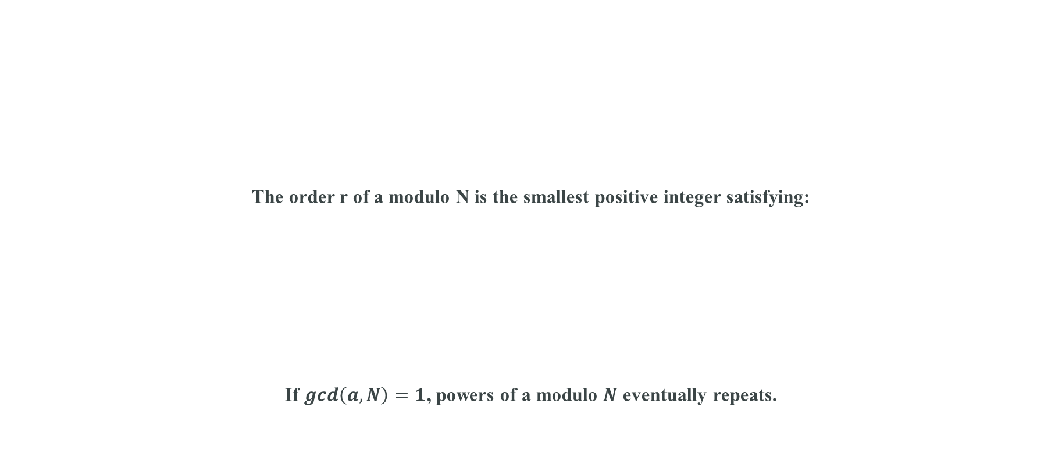

FROM FACTORING TO PERIOD FINDING
The order r of a modulo N is the smallest positive integer satisfying:
If $gcd\left(a, N\right)=1$, powers of a modulo $N$ eventually repeats.
$$f\left(x\right)=a^{x} mod N$$
Find period r
$$a^{r}≡1 (mod N)$$

Slide 14
SEE THE PERIOD
Powers of 2 modulo 15:
x=1 x=2 x=3 x=4 x=5 x=6 x=7 x=8
2
4
8
1
2
4
8
1
2¹, 2², 2³, 2⁴ (mod 15) = 2, 4, 8, 1 → repeats
order r = 4

Slide 15
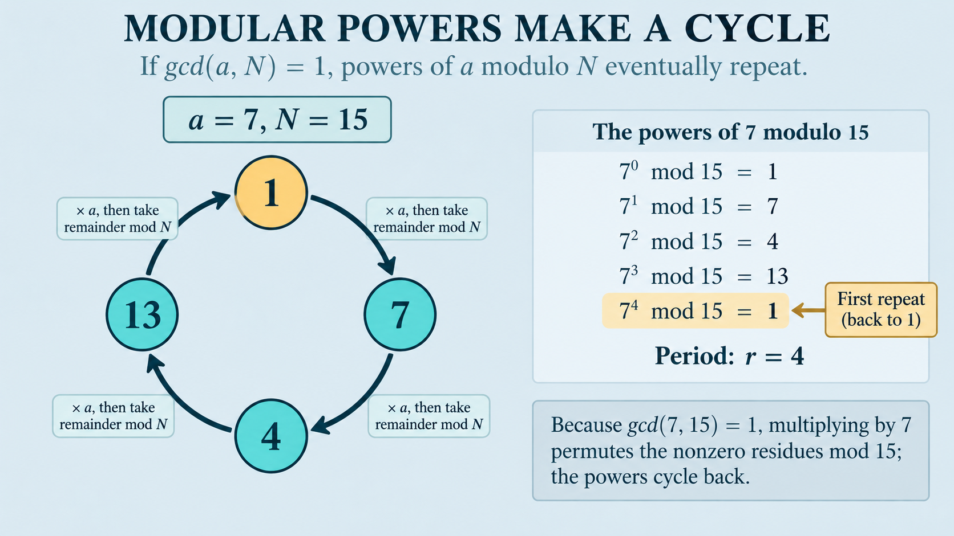

Slide 16
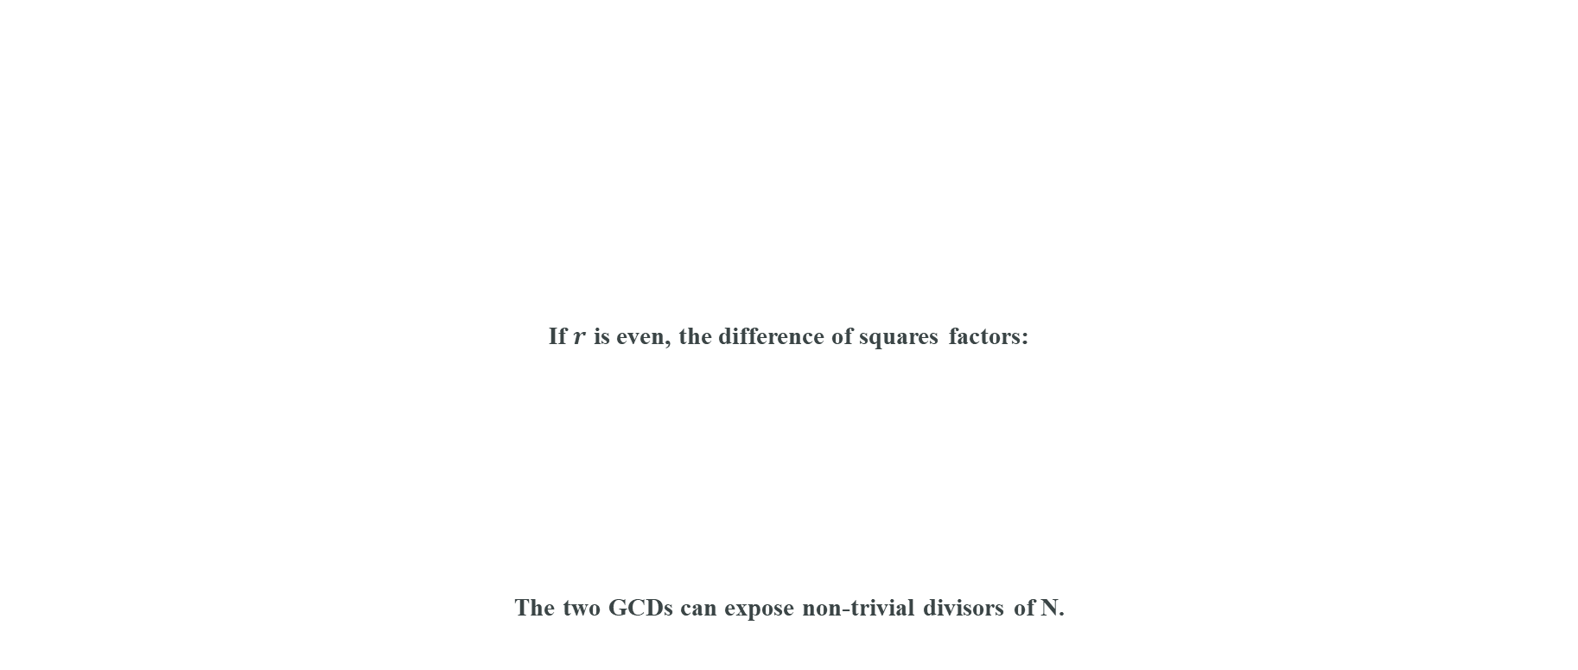
WHY AN EVEN PERIOD CAN REVEAL FACTORS
If $r$ is even, the difference of squares factors:
The two GCDs can expose non-trivial divisors of N.
aʳ ≡ 1 (mod N)
aʳ − 1 ≡ 0
(aʳᐟ²−1)(aʳᐟ²+1) ≡ 0
aʳ − 1 = (aʳᐟ² − 1)(aʳᐟ² + 1)

Slide 17



CLASSICAL SHOR WORKFLOW
Only “Find order r” is the quantum bottleneck.
Everything else is efficient classical number theory.
Input N
Choose $a$
gcd(a,N)
Find order $r$
Check $r$
Two GCDs
Factor

Slide 18
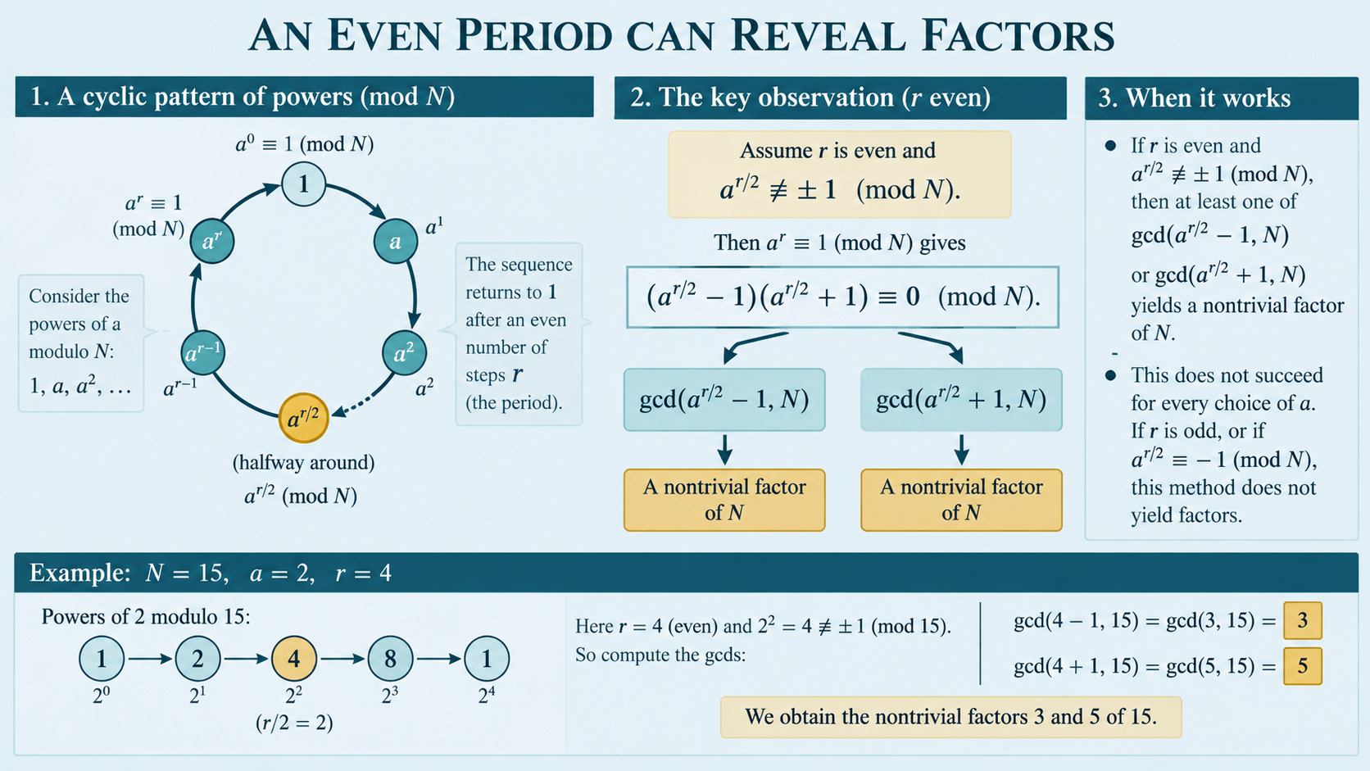

Slide 19
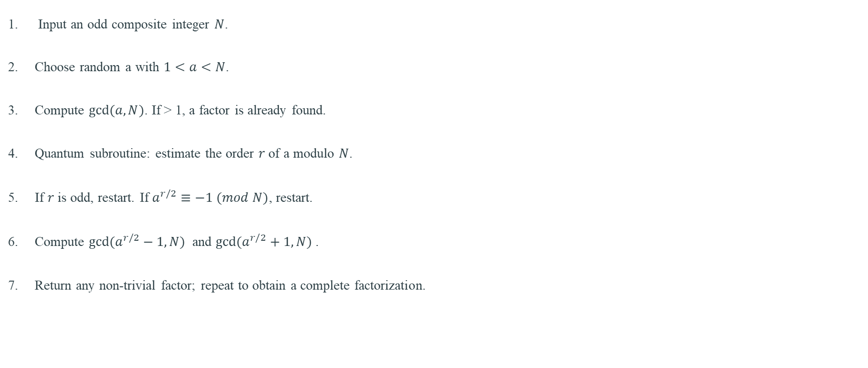
SHOR’S ALGORITHM — HIGH-LEVEL STEPS
Input an odd composite integer $N$.
Choose random a with $1<a<N$.
Compute $gcd⁡(a,N)$. If > 1, a factor is already found.
Quantum subroutine: estimate the order $r$ of a modulo $N$.
If $r$ is odd, restart. If $a^{r/2}≡−1 (mod N)$, restart.
Compute ${gcd⁡(a}^{r/2}−1, N)$ and ${gcd⁡(a}^{r/2}+1, N)$.
Return any non-trivial factor; repeat to obtain a complete factorization.

Slide 20
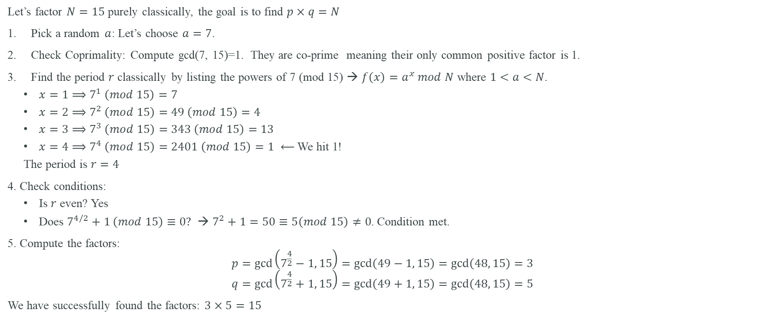
A Purely Classical Numerical Example
Let’s factor $N=15$ purely classically, the goal is to find $p×q=N$
Pick a random $a$: Let’s choose $a=7$.
Check Coprimality: Compute gcd(7, 15)=1. They are co-prime meaning their only common positive factor is 1.
Find the period $r$ classically by listing the powers of 7 (mod 15) → $f\left(x\right)=a^{x} mod N$ where $1<a<N$.
  $x=1⟹7^{1} \left(mod 15\right)=7$
  $x=2⟹7^{2} \left(mod 15\right)=49 \left(mod 15\right)=4$
  $x=3⟹7^{3} \left(mod 15\right)=343 \left(mod 15\right)=13$
  $x=4⟹7^{4} \left(mod 15\right)=2401 \left(mod 15\right)=1$ $⟵$ We hit 1!
  The period is $r=4$
4. Check conditions:
  Is $r$ even? Yes
  Does $7^{4/2}+1 \left(mod 15\right)≡0?$ → $7^{2}+1=50≡5\left(mod 15\right)≠0$. Condition met.
5. Compute the factors:
$$p=\gcd\left(7^{\frac{4}{2}}−1, 15\right)=\gcd\left(49−1, 15\right)=\gcd\left(48, 15\right)=3$$
$$q=\gcd\left(7^{\frac{4}{2}}+1, 15\right)=\gcd\left(49+1, 15\right)=\gcd\left(48, 15\right)=5$$
We have successfully found the factors: $3×5=15$

Slide 21
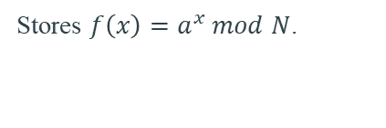
QUANTUM INGREDIENT 1 — SUPERPOSITION
Q is usually chosen as a power of two large enough to resolve the period.
$${\left.|0\right\rangle }^{0}\underset{→}{H^{⨂n}}\left(\frac{1}{\sqrt{Q}}\right)\sum_{x=0}^{Q−1}{\left.|x\right\rangle }$$
REGISTER 1
REGISTER 2
PURPOSE
Holds candidate exponents x in superposition.
Stores $f\left(x\right)=a^{x} mod N$.
Encode many function evaluations coherently.

Slide 22

QUANTUM INGREDIENT 2 — MODULAR EXPONENTIATION
Applied to the superposition:
This is a reversible quantum implementation of classical modular arithmetic.
$$U_{f}: \left.|x\right\rangle \left.|1\right\rangle →\left.|x\right\rangle \left.|a^{x} mod N\right\rangle$$
$$\frac{1}{\sqrt{Q}}\sum_{x}{\left.|x\right\rangle \left.|1\right\rangle →}\frac{1}{\sqrt{Q}}\sum_{x}{\left.|x\right\rangle \left.|a^{x} mod N\right\rangle }$$

Slide 23
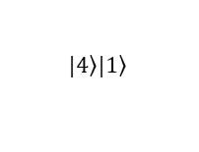
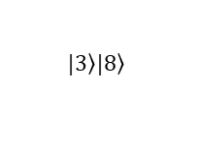
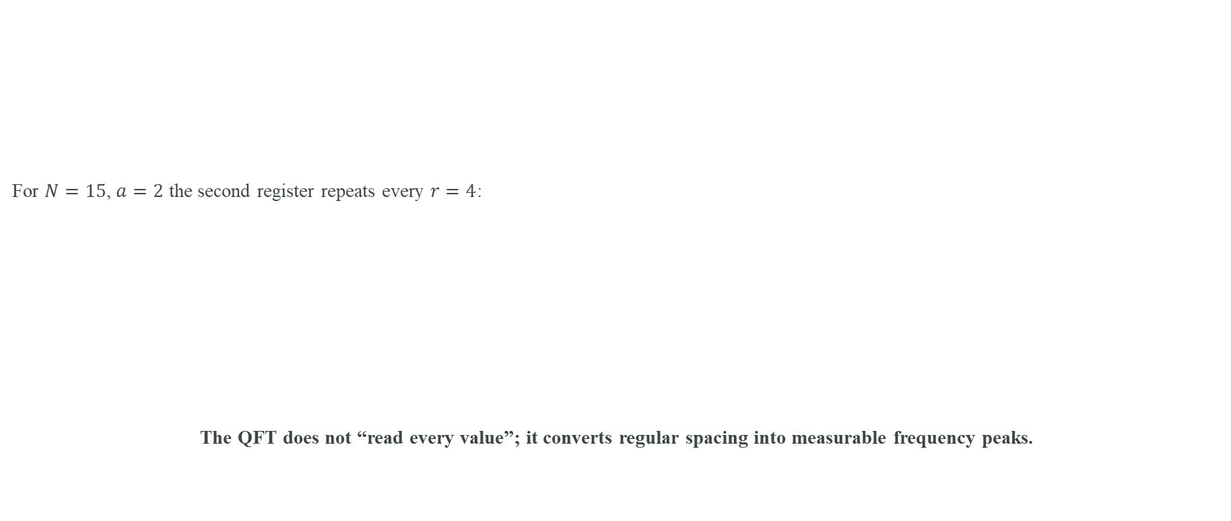
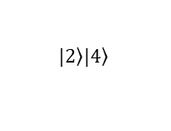
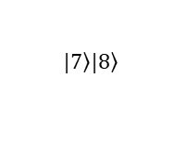
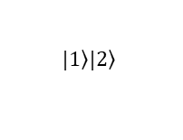
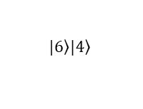
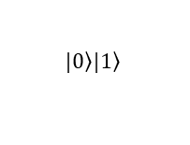
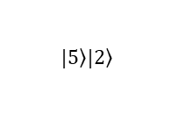
WHAT PERIODICITY LOOKS LIKE IN THE QUANTUM STATE
For $N=15$, $a=2$ the second register repeats every $r=4$:
The QFT does not “read every value”; it converts regular spacing into measurable frequency peaks.
$$|ψ⟩=\frac{1}{\sqrt{Q}}\sum_{x}{\left|x⟩\right|}a^{x} \operatorname{mod}{N} ⟩.$$
$$\left.|0\right\rangle \left.|1\right\rangle$$
$$\left.|1\right\rangle \left.|2\right\rangle$$
$$\left.|2\right\rangle \left.|4\right\rangle$$
$$\left.|3\right\rangle \left.|8\right\rangle$$
$$\left.|4\right\rangle \left.|1\right\rangle$$
$$\left.|5\right\rangle \left.|2\right\rangle$$
$$\left.|6\right\rangle \left.|4\right\rangle$$
$$\left.|7\right\rangle \left.|8\right\rangle$$

Slide 24
QUANTUM FOURIER TRANSFORM (QFT)
The frequency detector:
Shor uses the inverse QFT in the phase-estimation/order-finding circuit.
$${QFT}_{Q}\left.|x\right\rangle =\frac{1}{\sqrt{Q}}\sum_{k=0}^{Q−1}{e^{2πixk/Q}\left.|k\right\rangle }$$
INPUT VIEW
QFT
OUTPUT VIEW
Amplitude pattern over x.
Interference combines phases.
Peaks encode reciprocal period.

Slide 25
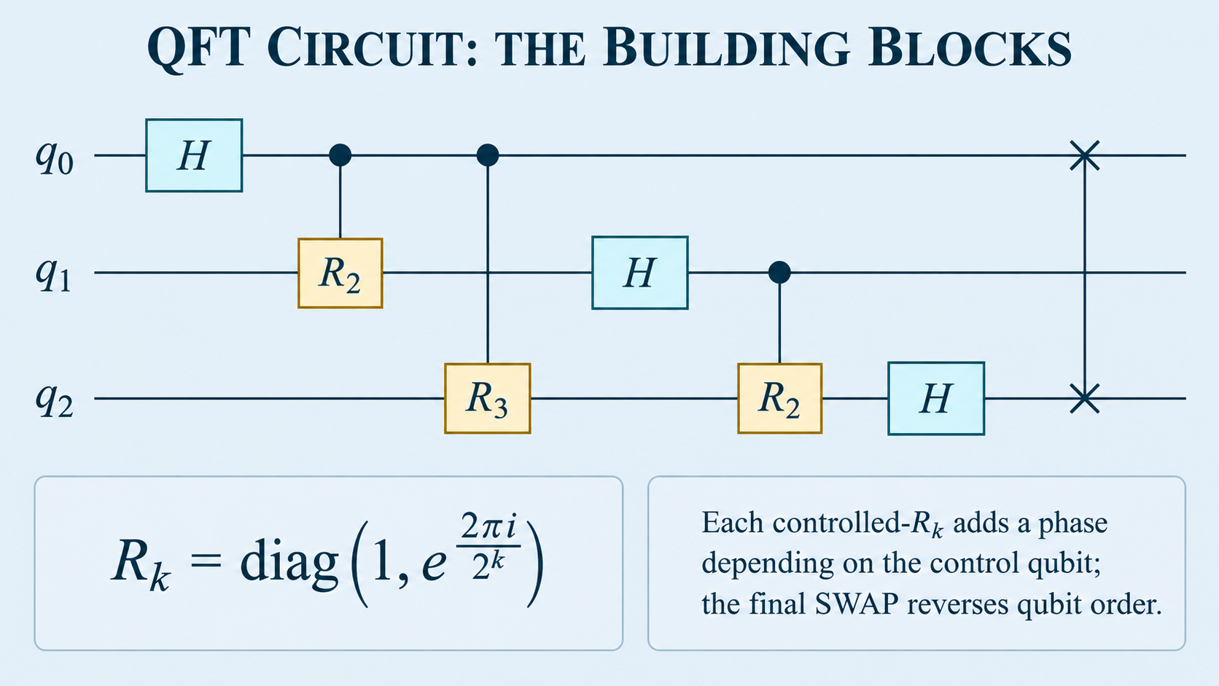

Slide 26

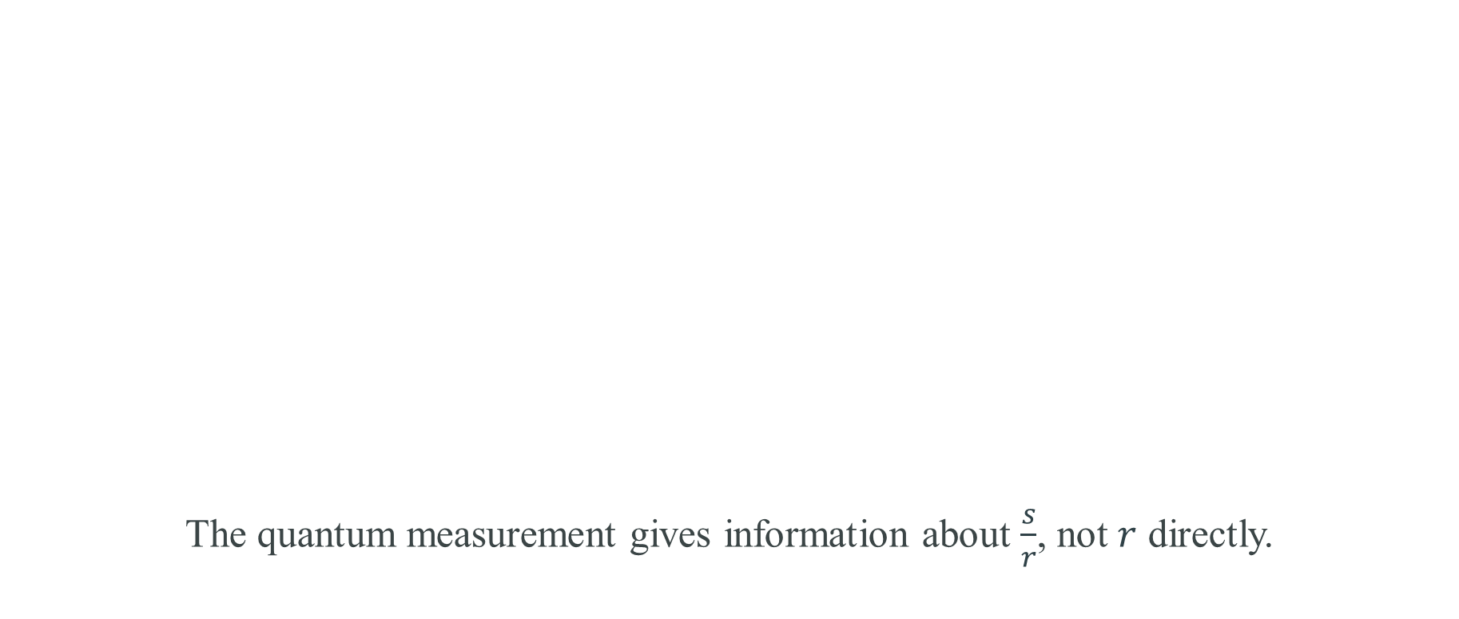

PHASE ESTIMATION VIEW OF ORDER FINDING
The quantum measurement gives information about $\frac{s}{r}$, not $r$ directly.
$$U_{a}\left|y⟩=\right|ay \operatorname{mod}{N} ⟩.$$
eigenvalue = $e^{2πis/r}$
phase $φ=\frac{s}{r}$ → estimate $φ$ → recover denominator $r$

Slide 27
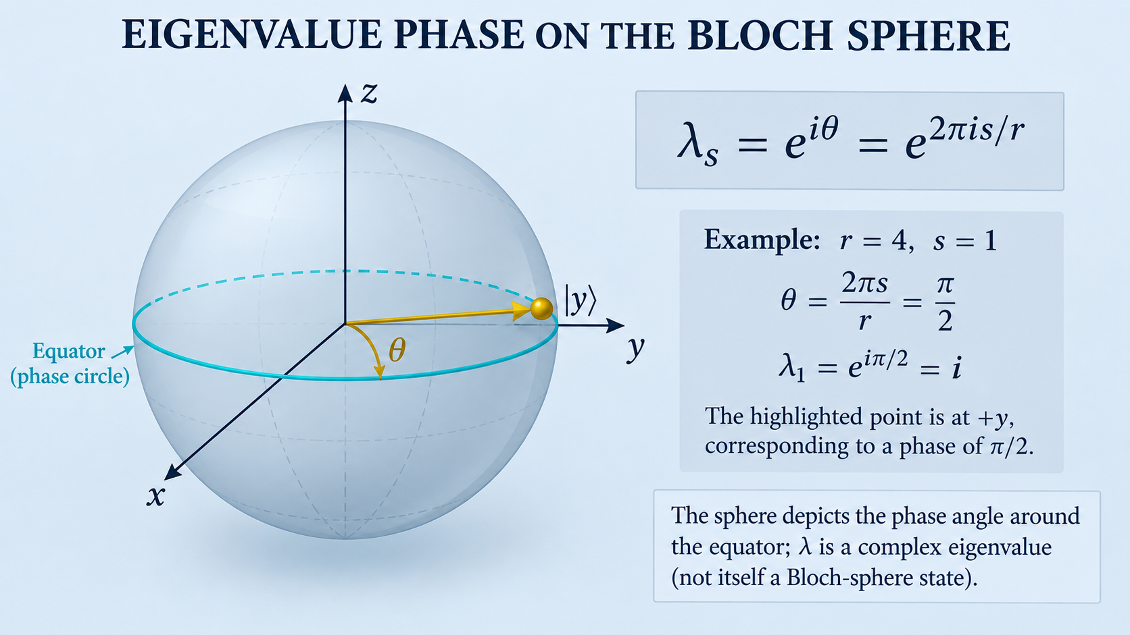

Slide 28
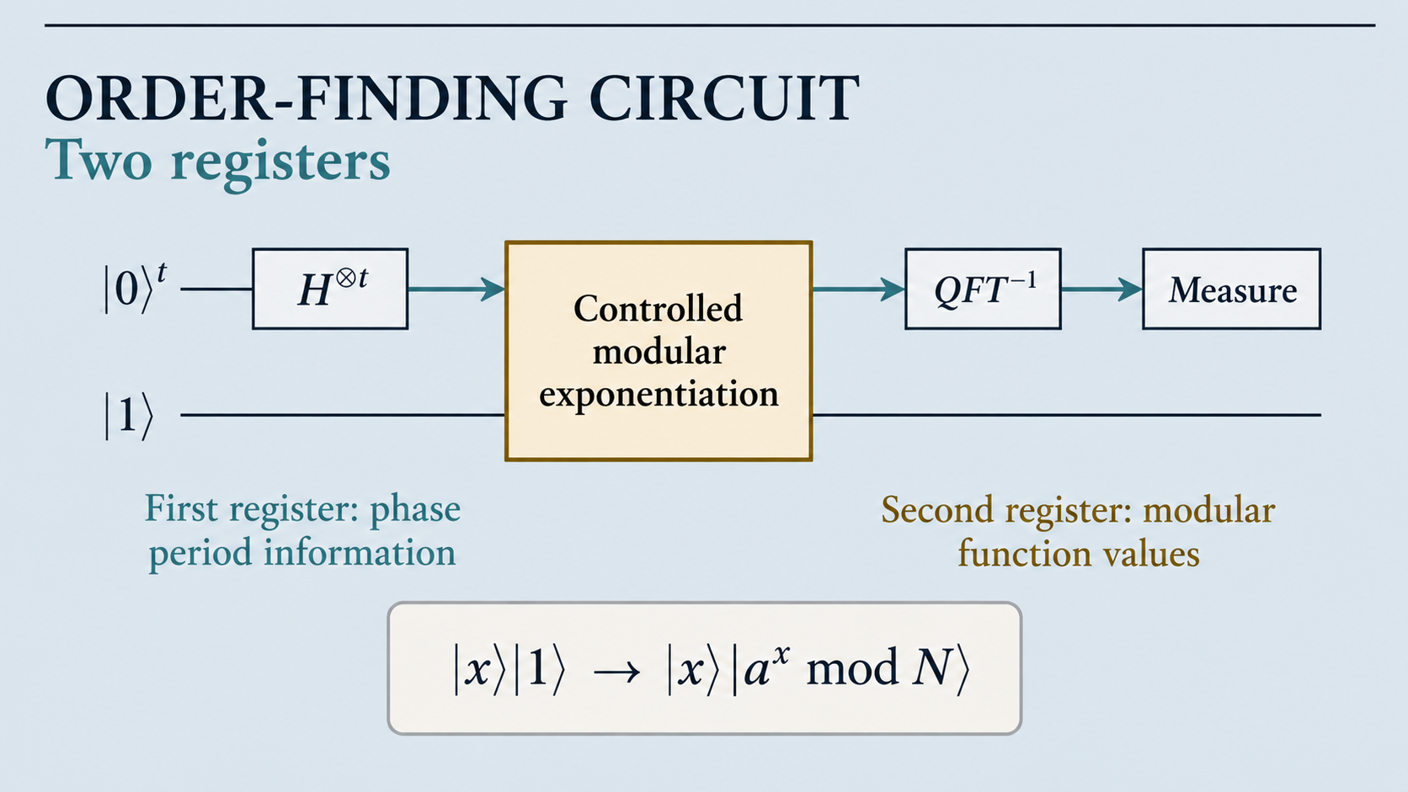

Slide 29
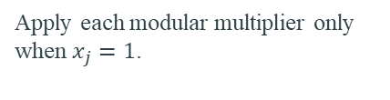
CONTROLLED POWERS IN MODULAR EXPONENTIATION
Write x in binary:
Then:
$$x=x_{0}2^{0}+x_{1}2^{1}+⋯+x_{t−1}2^{t−1},$$
$$a^{x} \operatorname{mod}{N} =\prod_{j=0}^{t−1}{{\left(a^{2^{j}} \operatorname{mod}{N} \right)}^{x_{j}}} \operatorname{mod}{N}$$
PRECOMPUTE
CONTROL
REVERSIBLE
a¹, a², a⁴, a⁸, … modulo N
Apply each modular multiplier only when $x_{j}=1$.
Build from reversible arithmetic gates.

Slide 30
AFTER MEASUREMENT: WHAT DO WE GET?
We know c and Q. We want the unknown denominator r.
Classical post-processing uses continued fractions to find a simple rational approximation to c/Q.
measurement c ≈ Q · s/r
c/Q ≈ s/r

Slide 31
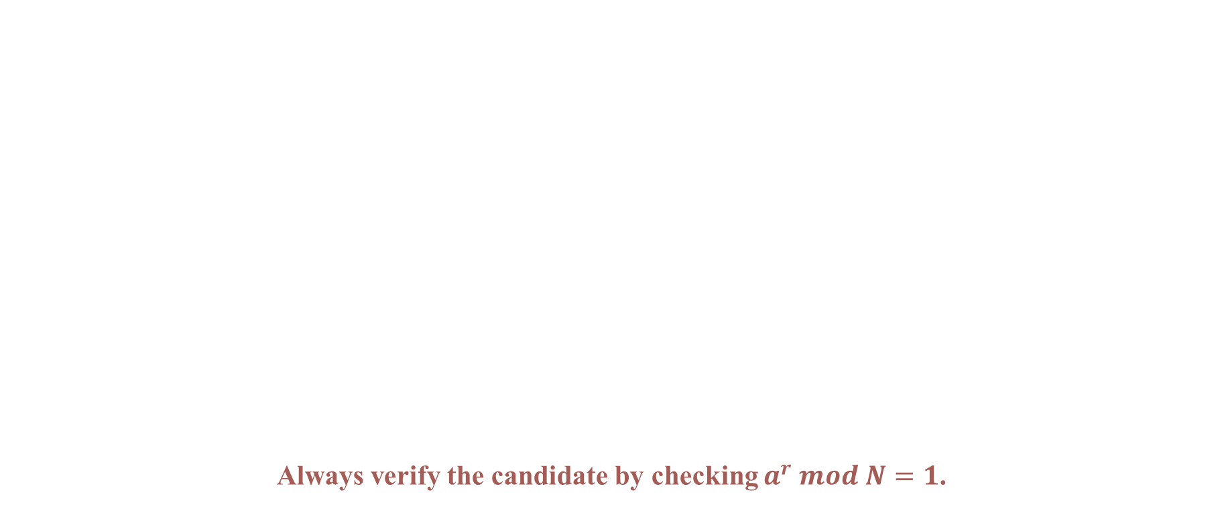
CONTINUED FRACTIONS — WHY THEY APPEAR
Always verify the candidate by checking $a^{r} mod N=1$.
c/Q ≈ s/r
continued fraction
candidate r
EXAMPLE IDEA
REALISTIC CASE
0.25 = 1/4 exactly, so denominator 4 is an immediate candidate period.
If measurement gives a nearby decimal, continued fractions finds a nearby low-denominator rational.

Slide 32
COMPLETE NUMERICAL EXAMPLE
Factor N = 15 using a = 2
N = 15, a = 2
GCD CHECK
PROCEED
gcd(2,15)=1
Need order of 2 mod 15
Therefore r = 4

Slide 33
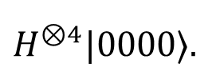
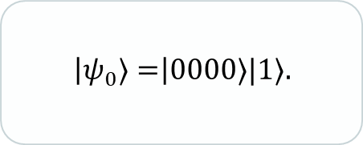
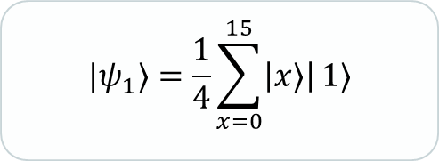
EXAMPLE — STEP 1: PREPARE SUPERPOSITION
Use a small illustrative Q = 16:
Every x from 0 to 15 has amplitude 1/4 and probability 1/16 before modular exponentiation.
Q=16 is pedagogical. Full precision analyses choose a larger first register.
$$\left|ψ_{0}⟩=\right|0000⟩|1⟩.$$
$$|ψ_{1}⟩=\frac{1}{4}\sum_{x=0}^{15}{\left|x⟩\right|}1⟩$$
$$H^{⊗4}|0000⟩.$$

Slide 34
EXAMPLE — STEP 2: COMPUTE $2^{x}$mod 15
The output register repeats 1,2,4,8 with period 4.
x=0
x=1
x=2
x=3
x=4
x=5
x=6
x=7
1
2
4
8
1
2
4
8
$$|ψ_{2}⟩=\frac{14}{\sum_{x=0}^{15}{\left|x⟩\right|}}2^{x} \operatorname{mod}{15} ⟩.$$

Slide 35
EXAMPLE — STEP 3: INVERSE QFT CREATES PEAKS
For exact period r=4 with Q=16, the first-register measurement is concentrated at:
c ∈ {0, 4, 8, 12}
These correspond to c/Q = 0, 1/4, 1/2, 3/4.
0
4
8
12

Slide 36
EXAMPLE — STEP 4: RECOVER r FROM A MEASUREMENT
Verify:
If c=8, 8/16=1/2 gives denominator 2 — only a divisor of r. Repeating can recover more information.
Suppose c = 4
c/Q = 4/16 = 1/4
r = 4
2⁴ mod 15 = 16 mod 15 = 1 ✓

Slide 37
EXAMPLE — STEP 5: EXTRACT THE FACTORS
Compute the two GCDs:
r = 4 ⇒ r/2 = 2
2² = 4
gcd(4 − 1, 15) = gcd(3,15) = 3
gcd(4 + 1, 15) = gcd(5,15) = 5
15 = 3 × 5

Slide 38
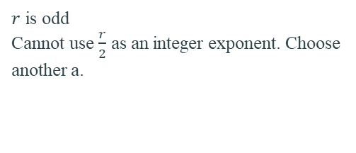
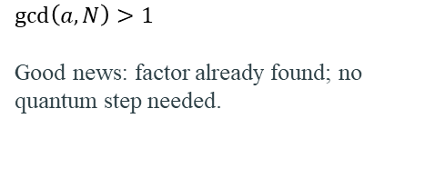
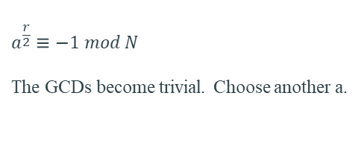
WHEN SHOR MUST RESTART
A failed trial does not invalidate the algorithm; randomised repetition gives another chance.
CASE 1
CASE 2
CASE 3
$$\gcd\left(a, N\right)>1$$
Good news: factor already found; no quantum step needed.
$r$ is odd
Cannot use $\frac{r}{2}$ as an integer exponent. Choose another a.
$$a^{\frac{r}{2}}≡−1 mod N$$
The GCDs become trivial. Choose another a.

Slide 39
A FAILURE EXAMPLE
N = 15, choose a = 14
Only trivial factors 1 and 15 → choose a different a.
14² mod 15 = 1 ⇒ r = 2
${14}^{\frac{r}{2}}$= 14 ≡ −1 (mod 15)
gcd(14−1,15)=1 and gcd(14+1,15)=15

Slide 40
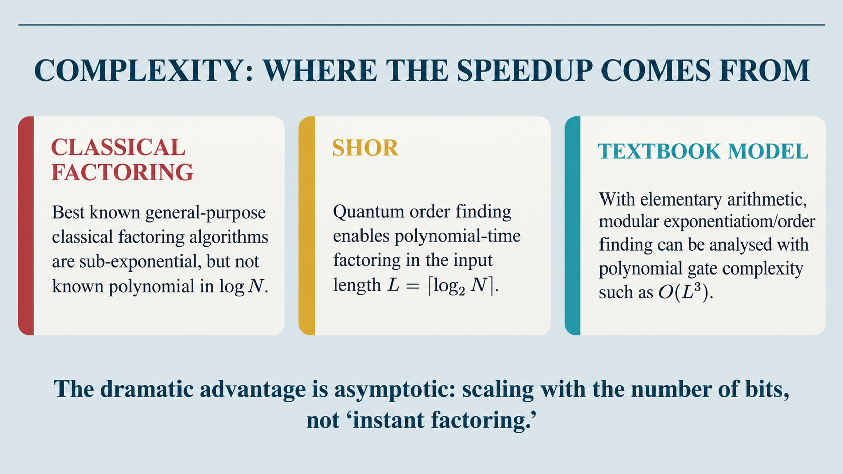

Slide 41
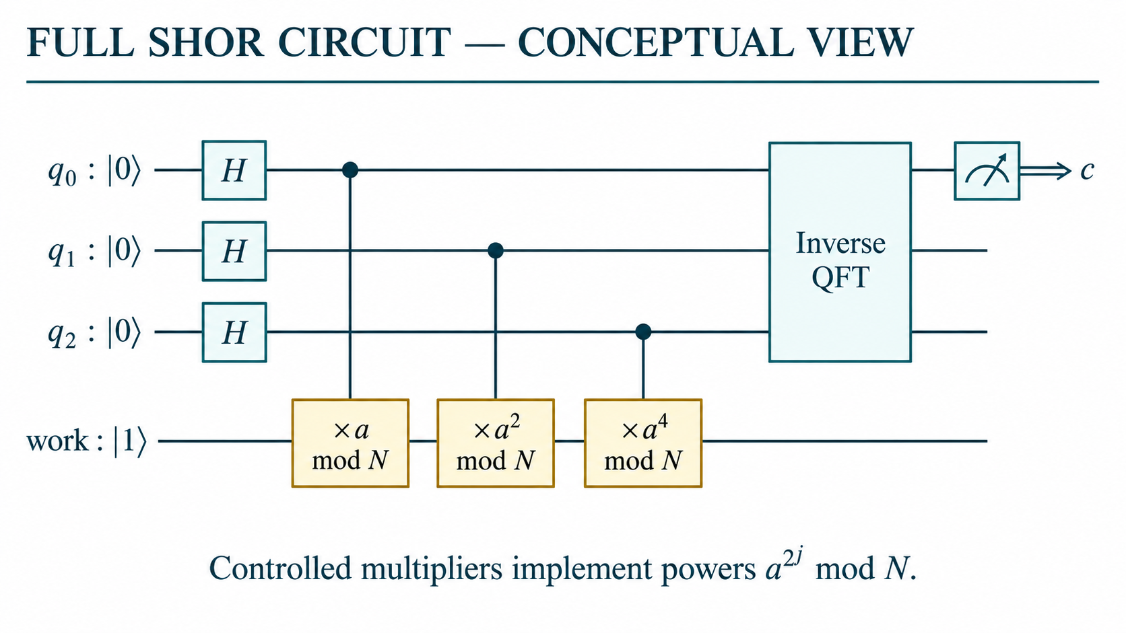

Slide 42
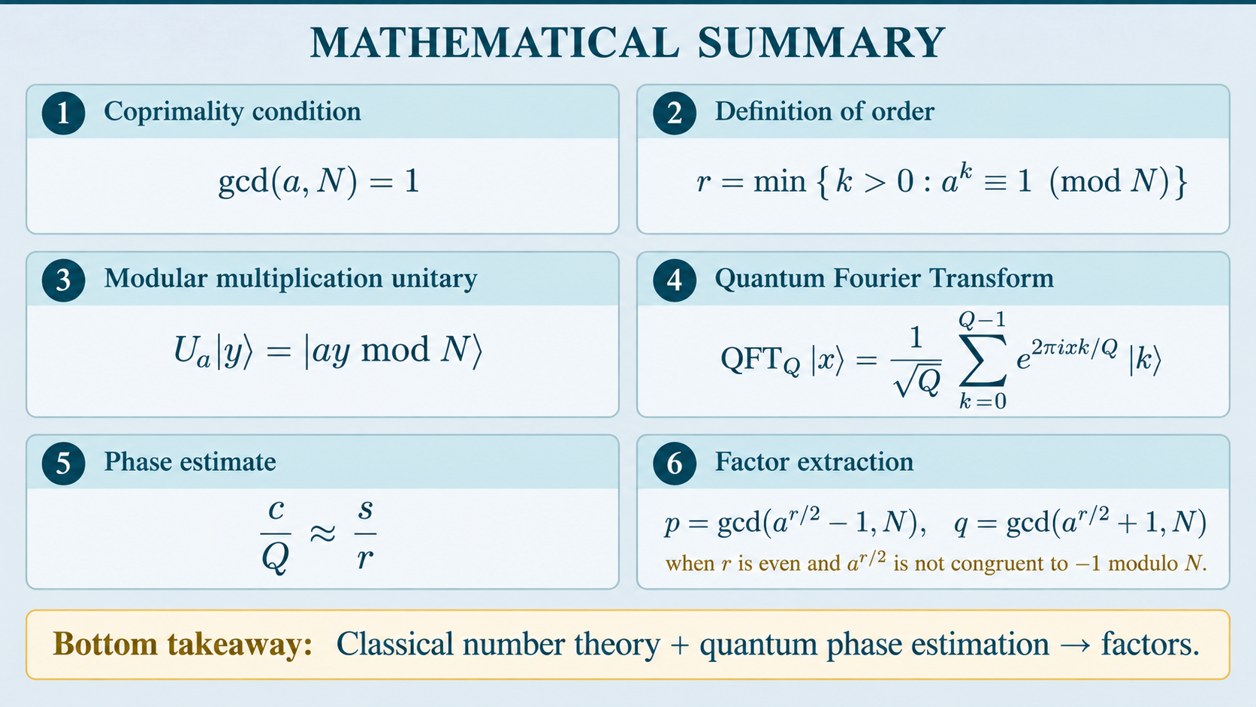

Slide 43
COMMON MISCONCEPTIONS
“QFT outputs the factors.”
“Superposition tests every factor.”
“One run always works.”
No. QFT helps estimate a phase/period.
No. Interference extracts global periodic structure.
No. Random choices and measurements can require repetition.
“GCD is quantum.”
“Shor breaks RSA today.”
No. Euclidean GCD is efficient classical arithmetic.
Not with current fault-tolerant resources; the result is a scalability threat.

Slide 44
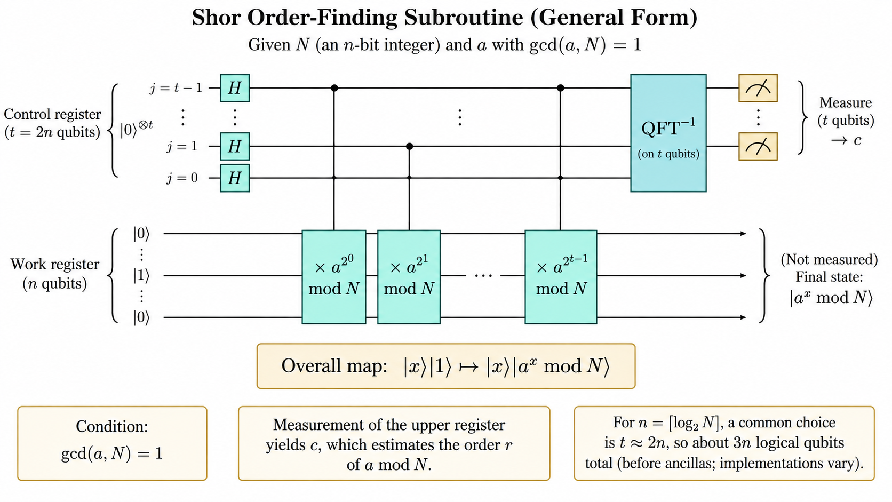

Slide 45


